Slide 1
Non – volatile memory (ROM)
Prepared by Ganapathi

Slide 2
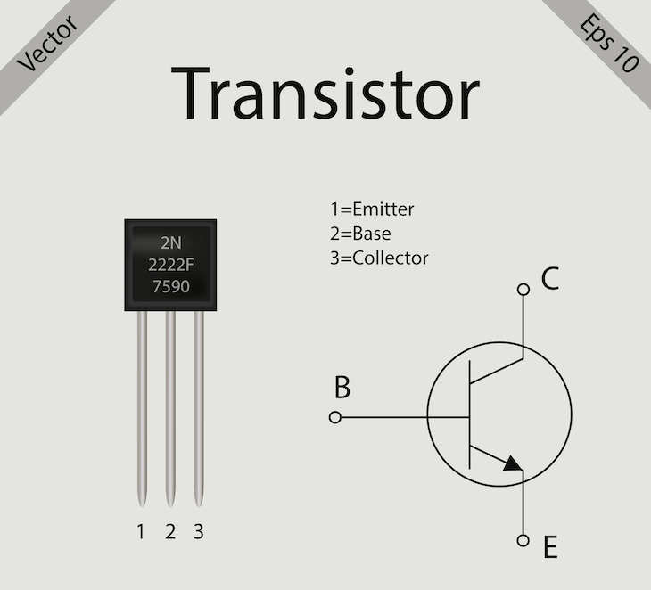
What is a Transistor?
A transistor is a tiny electronic switch or amplifier made from semiconductor material (silicon).
It can switch ON/OFF a current (like a digital 1 or 0).
It can amplify signals (make a weak signal stronger).
It is the building block of all modern electronics (ROM, RAM, CPU, mobile chips, etc.).
Think of it like a valve in water pipes:
When the valve is open → water flows = current flows (logic 1).
When the valve is closed → water stops = no current (logic 0).

Slide 3
Types of Transistors
2. Two main families:
(A) BJT (Bipolar Junction Transistor)
Older type, uses current to control current.
Has 3 terminals: Emitter, Base, Collector.
Example use: Amplifiers.
(B) MOSFET (Metal-Oxide-Semiconductor Field Effect Transistor)
Modern type, used in digital circuits (CPU, ROM, RAM).
Uses voltage at the gate to control current flow.
Has 3 terminals: Source, Gate, Drain.
Much smaller, faster, and efficient → used in billions on chips.

Slide 4
Transistor Terminals
For MOSFET (used in memory and logic circuits):
Gate (G): Control pin (like a switch handle).
Source (S): Where current enters.
Drain (D): Where current exits.
Operation:
If voltage applied to Gate → path opens between Source and Drain → current flows (ON).
If no voltage → path is closed → no current (OFF).

Slide 5
Types of Transistors
🔹 4. Transistors in Digital Logic
One transistor → simple switch.
Few transistors → logic gates (AND, OR, NOT).
Millions of transistors → microprocessor (CPU).
Billions of transistors → modern chips (Intel i9, ARM, etc.).
Example:
In ROM, each memory cell is made of transistors.
In CPU, transistors build adders, multipliers, registers.
In RAM, a single bit may use 1 transistor + 1 capacitor.

Slide 6
5. Why Transistors are Important
Replace bulky vacuum tubes.
Small (nanometer scale).
Cheap and mass-producible.
Switch at GHz speeds.
Low power consumption.

Slide 7
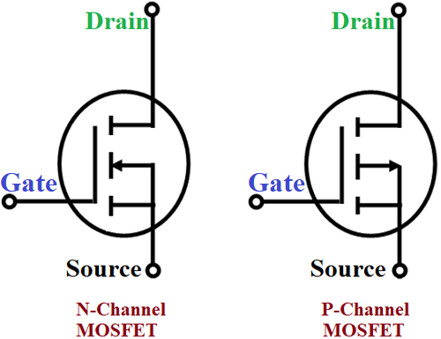
MOSFET Symbol (used in ROM/CPU):

Slide 8
Designing of ROM
1. ROM is made of Basic Digital Circuits
Inside ROM, you’ll find combinational logic circuits and memory cells built from transistors. The main circuits are:
Address Decoder Circuit
Built using logic gates (NAND, NOR).
Converts the binary address input into a single active word line.
Example: If you input 010, decoder activates only row 2.
Memory Cell Array
A matrix (rows × columns) of memory cells.
Each memory cell is a small circuit that stores a bit (0 or 1).
Types of circuits used:
Mask ROM: Hardwired transistor/diode at each cross-point.
EPROM/EEPROM/Flash: Uses floating-gate MOSFETs as memory cells.

Slide 9
Designing of ROM
Sense Amplifier Circuit
Reads the tiny voltage/current from the memory cell and converts it into a clear digital 0 or 1.
Needed because the memory cell signal is very weak.
Output Buffer Circuit
Strengthens the data signal so it can travel outside the chip to the CPU.
Works like a driver/amplifier.
Control Logic Circuit
Manages signals like:
CE (Chip Enable) → activates the ROM chip.
OE (Output Enable) → enables data output to bus.
WE (Write Enable) → only in EEPROM/Flash (for programming).

Slide 10
Designing of ROM
2. Basic Memory Cell Circuit (Inside ROM)
Each memory cell is very simple, but depends on ROM type:
(A) Mask ROM Cell (Hardwired)
At the cross of word line (row) and bit line (column):
If a transistor/diode is connected → logic “1”.
If no connection → logic “0”.
Circuit:
Word Line ────●──── Bit Line → "1" Word Line ───────X──── Bit Line → "0"
(B) EPROM/EEPROM/Flash Cell (Floating Gate MOSFET)
Uses a MOSFET transistor with an extra gate (floating gate).
If electrons are trapped → transistor OFF = “0”.
If no electrons → transistor ON = “1”.

Slide 11
Circuit Sample:
Control Gate
│
┌─────┴──────┐
│ Floating │ ← stores charge (electrons)
│ Gate │
└────────────┘
│
MOSFET Channel

Slide 12
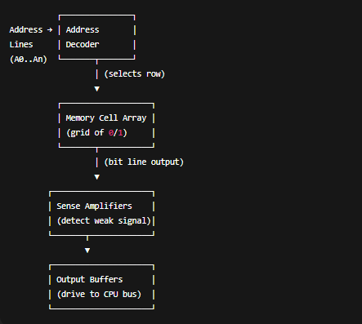
Block diagram of circuit insite (ROM)

Slide 13
What is a Memory Cell?
A memory cell is the basic electronic circuit inside a memory chip that stores 1 bit of data (either 0 or 1).
1 memory cell = 1 binary value (0 or 1).
Millions/billions of cells are arranged in a grid (array) to make a memory chip.
So when you say a chip is 1 KB (1024 bytes) → it actually has 8192 memory cells (since 1 byte = 8 bits).
What Does a Memory Cell Contain?
Depends on the type of memory (ROM, RAM, Flash, etc.).
(A) In Mask ROM
Each memory cell = a fixed connection (wired transistor or diode).
Connection present = “1”
No connection = “0”

Slide 14
What is a Memory Cell?
A memory cell is the basic electronic circuit inside a memory chip that stores 1 bit of data (either 0 or 1).
1 memory cell = 1 binary value (0 or 1).
Millions/billions of cells are arranged in a grid (array) to make a memory chip.
So when you say a chip is 1 KB (1024 bytes) → it actually has 8192 memory cells (since 1 byte = 8 bits).
What Does a Memory Cell Contain?
Depends on the type of memory (ROM, RAM, Flash, etc.).
(A) In Mask ROM
Each memory cell = a fixed connection (wired transistor or diode).
Connection present = “1”
No connection = “0”

Slide 15
What is a Memory Cell?
B) In EPROM/EEPROM/Flash (non-volatile)
Each cell = a floating-gate MOSFET transistor
How it works:
If electrons are trapped in the floating gate → the transistor does not conduct → stores 0.
If gate has no electrons → transistor conducts → stores 1.
Because electrons are insulated inside the floating gate, the bit is stored even if power is OFF.
(C) In RAM (volatile, for comparison)
SRAM cell → made of 6 transistors forming a flip-flop.
DRAM cell → made of 1 transistor + 1 capacitor (charge = “1”, no charge = “0”).
But DRAM loses charge when power is off → that’s why it’s volatile, unlike ROM.

Slide 16
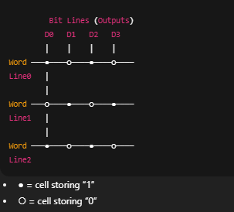
What is a Memory Cell?
3. Memory Cell in ROM (Simple View)
Imagine a grid of rows and columns:
Rows = word lines (selected by decoder)
Columns = bit lines (read the value)
At each intersection → a memory cell (transistor or connection).

Slide 17
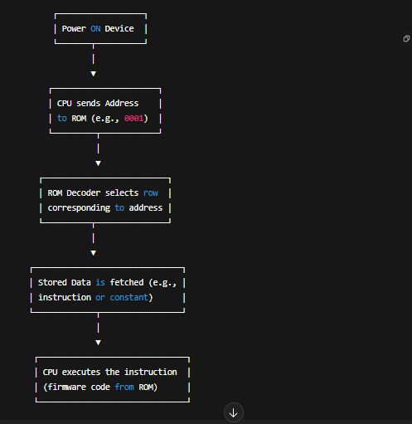
Flow chart of ROM operation

Slide 18
Real-Life Example
👉 Suppose you press the power button on a computer:
CPU has no program yet, so it looks at ROM.
ROM gives the BIOS program.
BIOS tells the CPU how to test RAM, load OS from hard disk.
Without ROM, the system cannot start.
👉 In a washing machine:
ROM stores the cycle steps (wash → rinse → spin).
When you select a mode, CPU reads from ROM and runs the sequence.

Slide 19
ROM in Simple Words
Non-volatile → Data stays even when power is OFF.
Used to store permanent programs/instructions needed for a device to work.
You can only read (normal use), but cannot easily write (depends on ROM type).

Slide 20
How Data is Stored in ROM
Inside ROM, data is stored as binary (0s and 1s).
A 0 means "no connection" (open circuit or low voltage).
A 1 means "connection" (closed circuit or high voltage).
These 0s and 1s are created using logic gates and transistor arrangements inside the silicon chip.
In Mask ROM → manufacturer decides the 0s and 1s during chip making (permanent).
In EPROM/EEPROM/Flash → special process (UV light or electrical charges) sets or clears the bits.
✅ Because ROM cells use floating-gate MOSFETs (for EEPROM/Flash) or hard-wired connections (for Mask ROM), the stored charges/paths remain even when power is OFF.

Slide 21
What Data is Stored in ROM
ROM typically stores firmware (software + hardware instructions). Examples:
Bootloader (first code that runs when you power ON a system).
BIOS/UEFI in computers.
Microcontroller programs (ex: Arduino sketch stored in Flash).
Lookup tables (ex: fonts, math constants).
Embedded appliance instructions (ex: washing machine wash cycle logic).
Security data (encryption keys, SIM card details).

Slide 22
Logic of ROM
ROM works like a big truth table (address → stored data).
You give an Address (input lines).
ROM returns the Stored Data (output lines).
Example:
So, ROM is basically a decoder + memory array:
Decoder selects the correct row (address).
Memory array outputs the stored bits.
Address (Input) | Stored Data (Output)
0000 | 10101010
0001 | 11110000
0010 | 01010101

Slide 23
Why ROM Keeps Data Without Power
Uses floating-gate transistors (EEPROM/Flash) → electrons trapped in an insulated gate = stores charge = binary “1” or “0”.
Or hardwired connections (Mask ROM) → physical wiring means permanent 0/1.
Since no constant power is needed to “hold” the data, ROM is non-volatile.

